Slide 1
LoCoBot & Navigation
2020/05/18
Teaching Staff

Slide 2
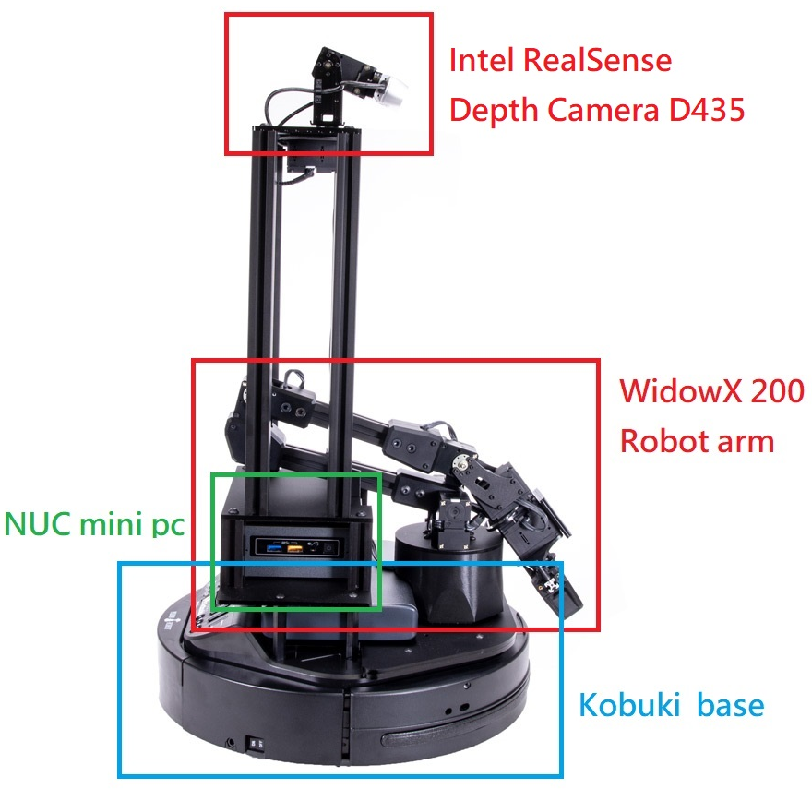
What is the LoCoBot?
Facebook AI’s PyRobot
A mobile manipulator research platform
Designed by Carnegie Mellon University

Slide 3
LoCoBot and PyRobot
PyRobot is an open source, lightweight, high-level interface on top of the robot operating system (ROS). It provides a consistent set of hardware-independent mid-level APIs to control different robots.
PyRobot abstracts away details about low-level controllers and interprocess communication so users can focus on building high-level AI robotics applications.

Slide 4
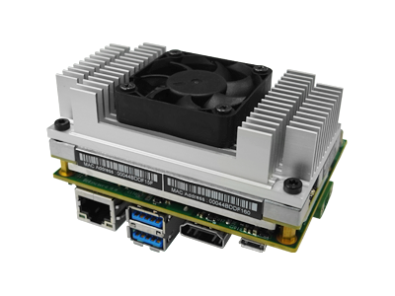
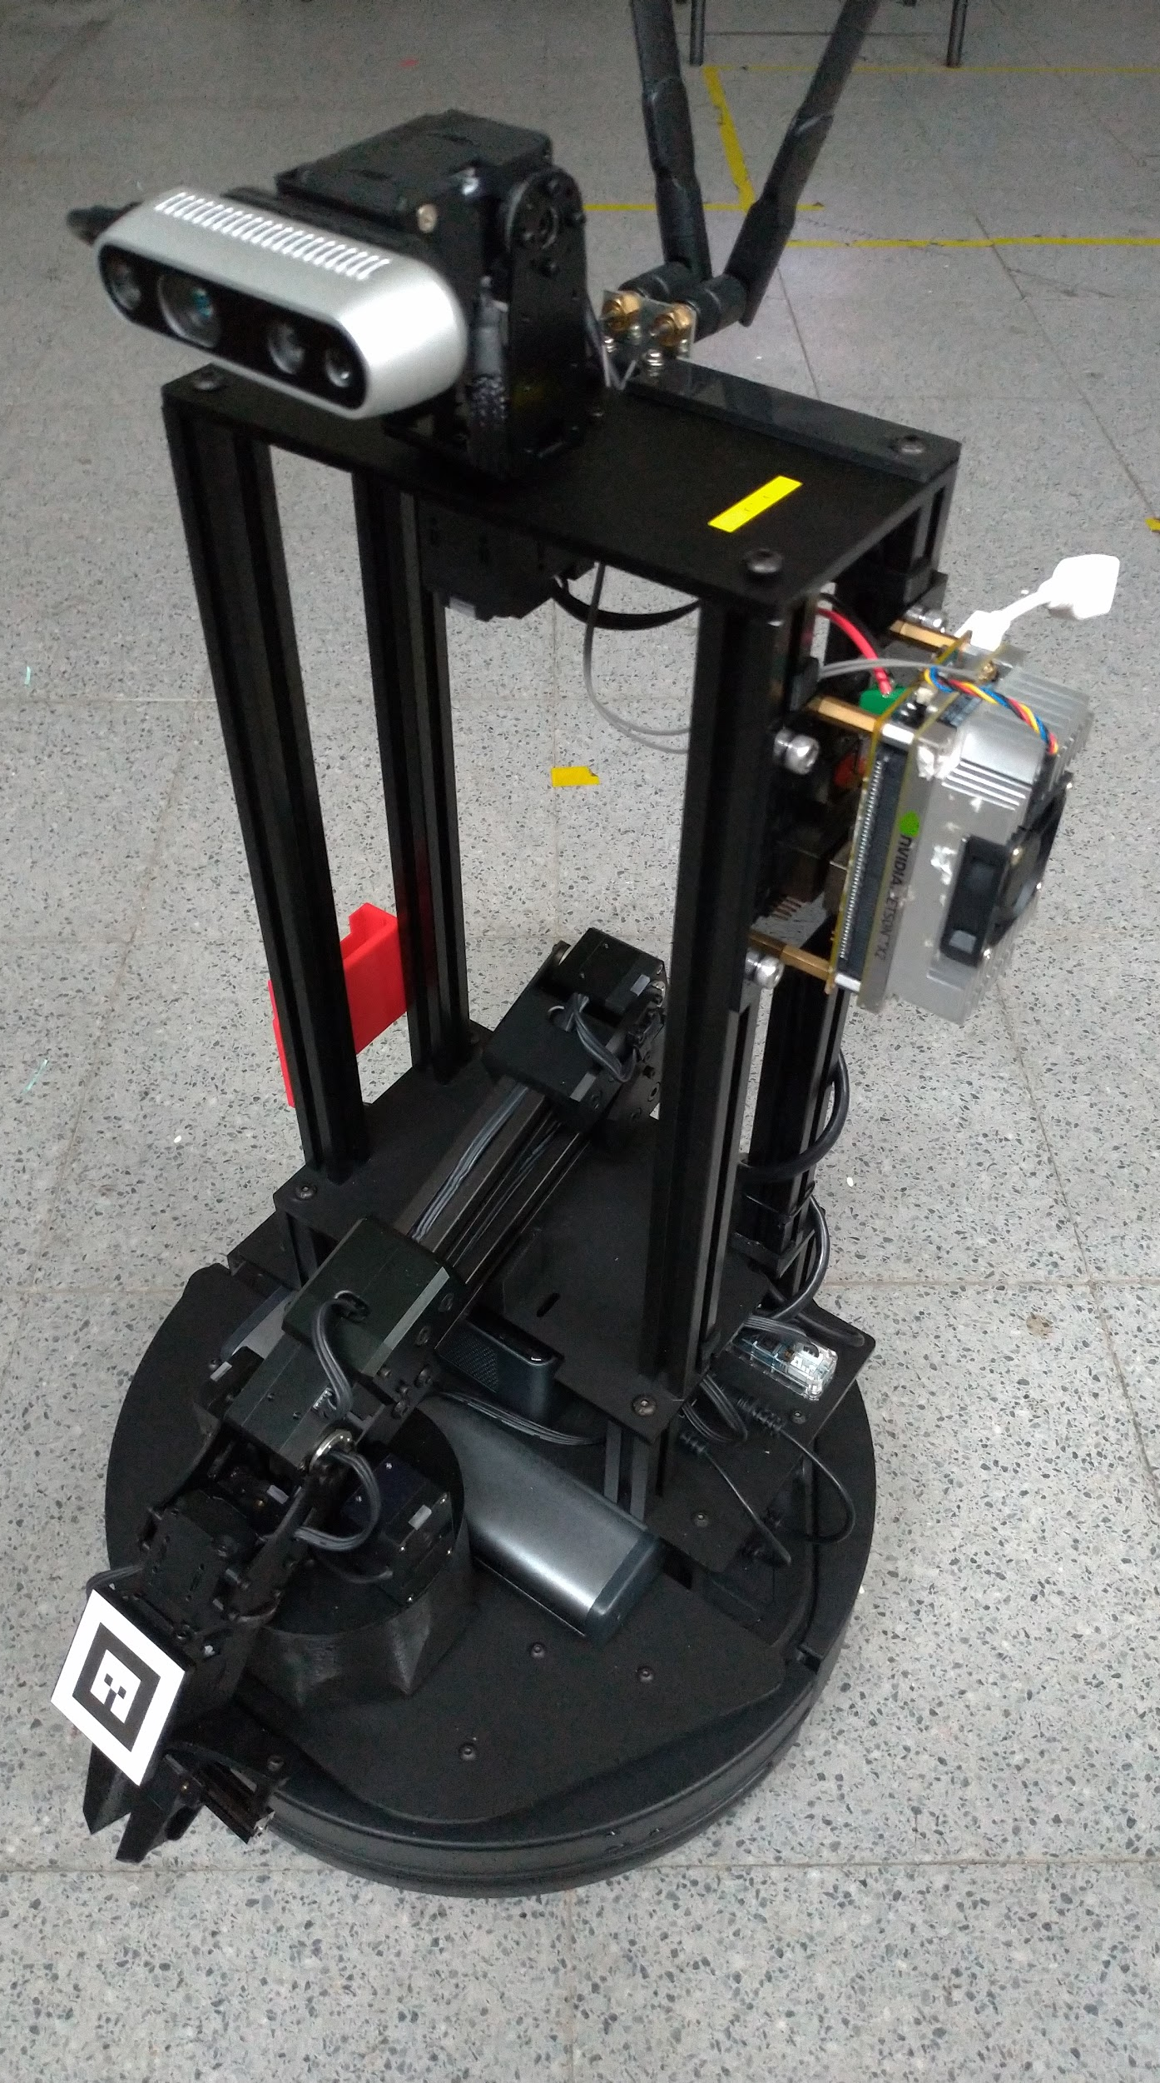
How will we use the LoCoBot?
TX2
Semantic Segmentation using deep learning
Pose Estimation using ICP
Path Planning

Slide 5
Robot navigation
The robot's ability to determine its own position in its frame of reference and then to plan a path towards some goal location.

Slide 6
Robot navigation
Navigation can be defined as the combination of the three fundamental competences :
Self-localization
Path planning
Map-building and map interpretation

Slide 7
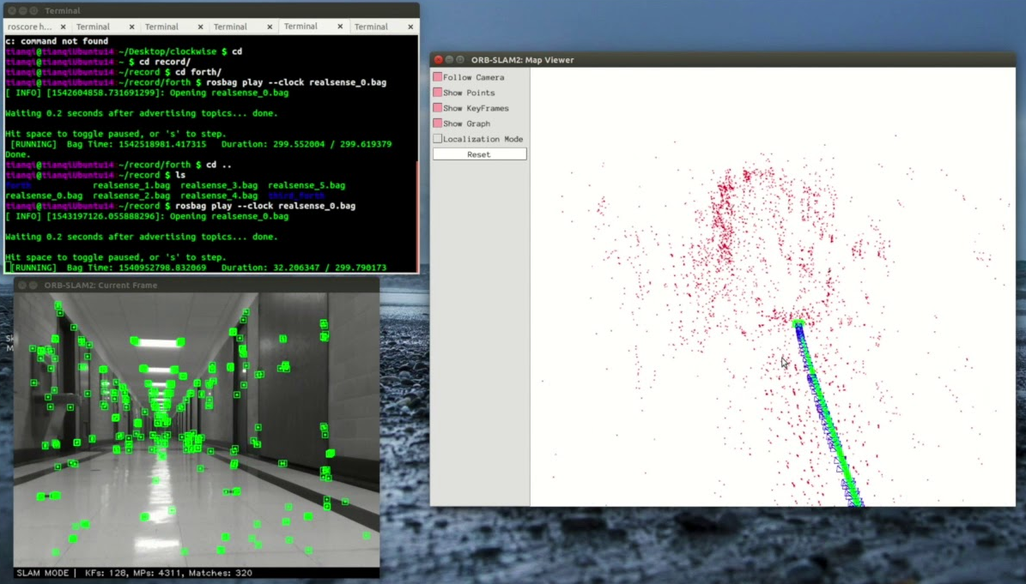
Vision-based navigation
Uses computer vision algorithms and optical sensors
laser-based range finder
photometric cameras
using CCD arrays, to extract the visual features required to the localization in the surrounding environment.

Slide 8
Vision-based navigation
There are a range of techniques for navigation and localization using vision information, the main components of each technique are :
representations of the environment.
sensing models.
localization algorithms.

Slide 9
SLAM
SLAM = Simultaneous localization and mapping
Robot starts from an unknown starting point and go through an unknown environment, relocates itself through the environment, reconstruct the environment it goes.
Do localization and mapping at once.

